Slide 1
Media Relations Manager
Molly Blancett

Slide 2
Media Relations
Goals:
Media Ambassadors Program: Identify experts in key, always-in-the-news, issues
Provide media training
Proactively pitch those faculty members to national media to use as expert sources
Campus communicators focus on local outreach

Slide 3
Results
Data from 2/13/2015 – 4/24/2015
62 story pitches
36 faculty placements, more to come
Key to early success:
Building relationships with The Conversation

Slide 4
The Conversation
Media site for commentary from academics
Daily requests and story pitches
Funders:
Alfred P. Sloan Foundation, Hewlett Foundation, Robert Wood Johnson Foundation
Managing Editors & Advisors:
Boston Globe, The Guardian, BBC, TED Content Producer Founder for the Center for Public Integrity

Slide 5
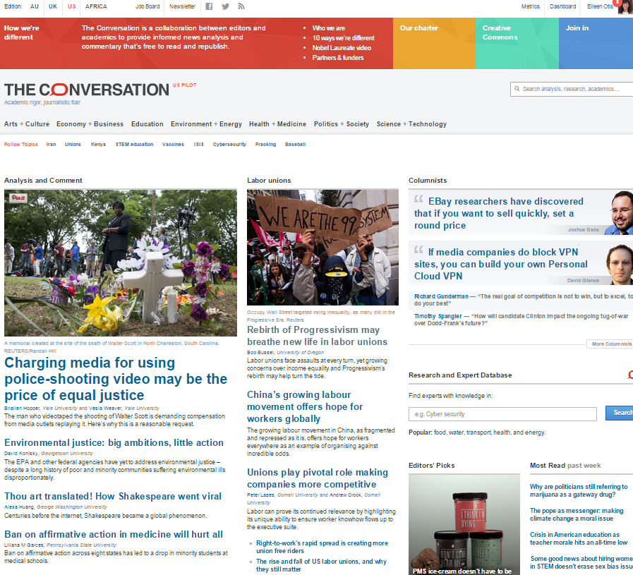
The Conversation
Media site for commentary from academics
Funders: Alfred P. Sloan Foundation, Hewlett Foundation, Robert Wood Johnson Foundation
Managing Editors & Advisors: Boston Globe, The Guardian, BBC, TED Content Producer Founder for the Center for Public Integrity

Slide 6
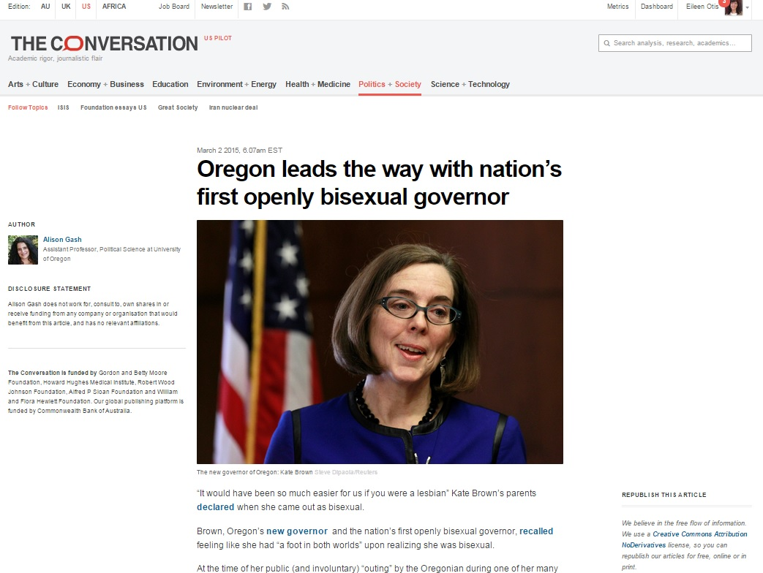
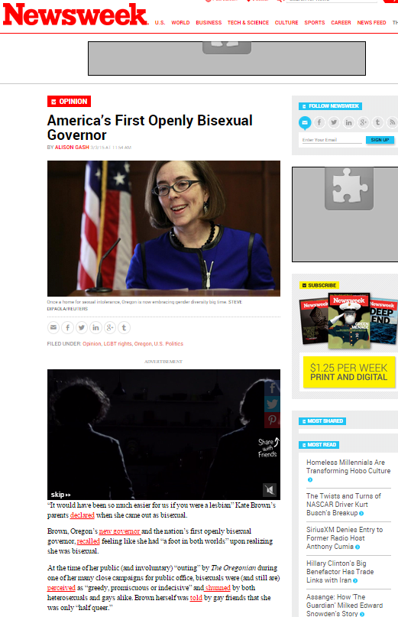
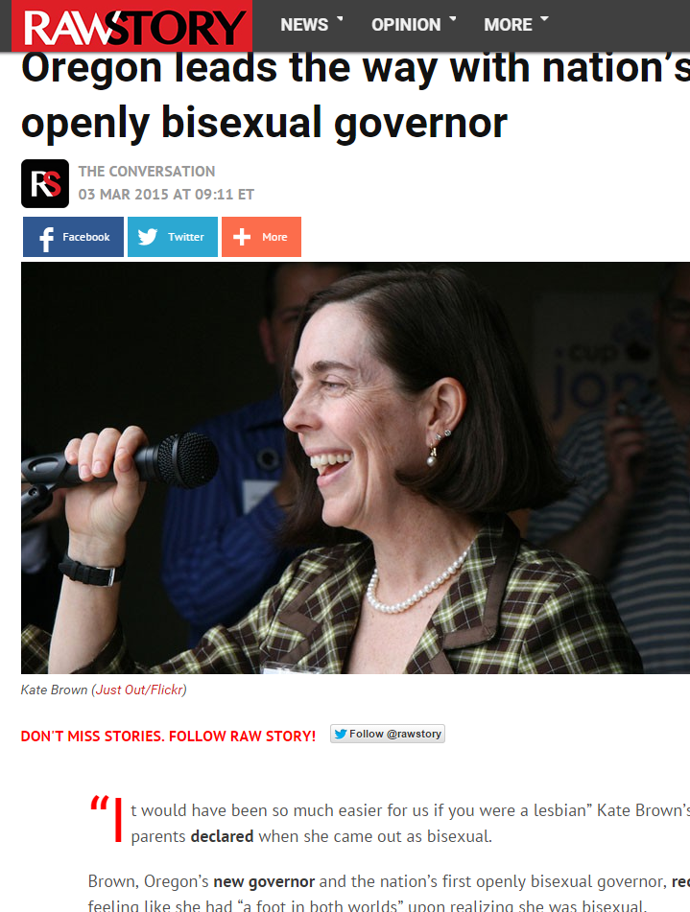
Examples
im ac nisl rutrum vulputate.

Slide 7
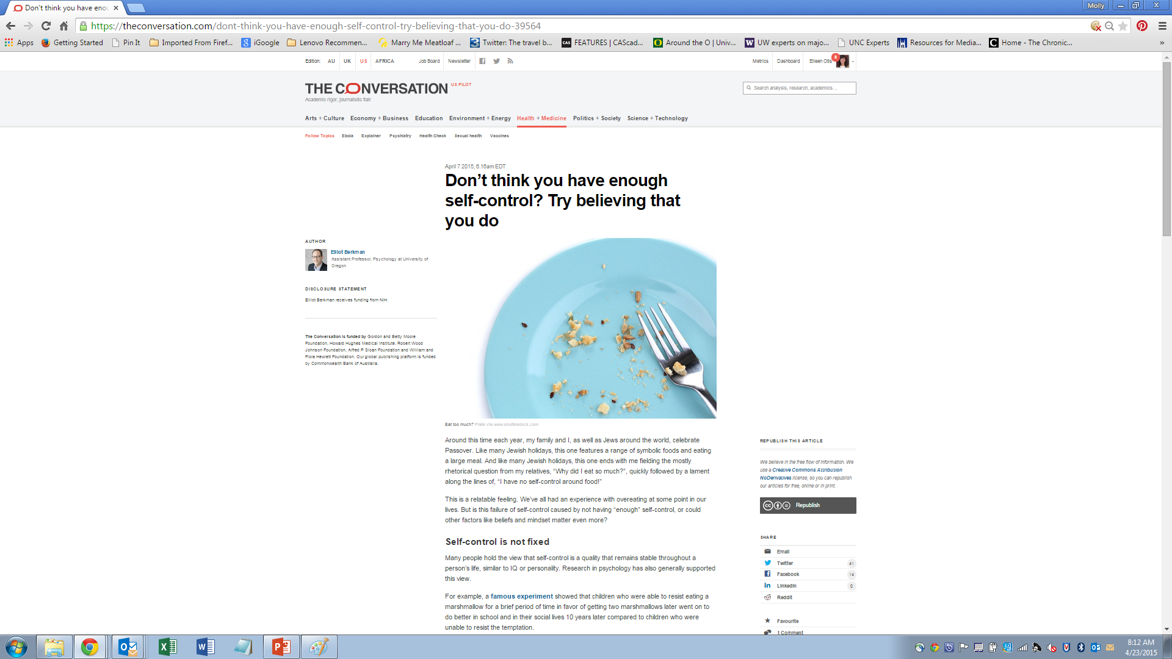
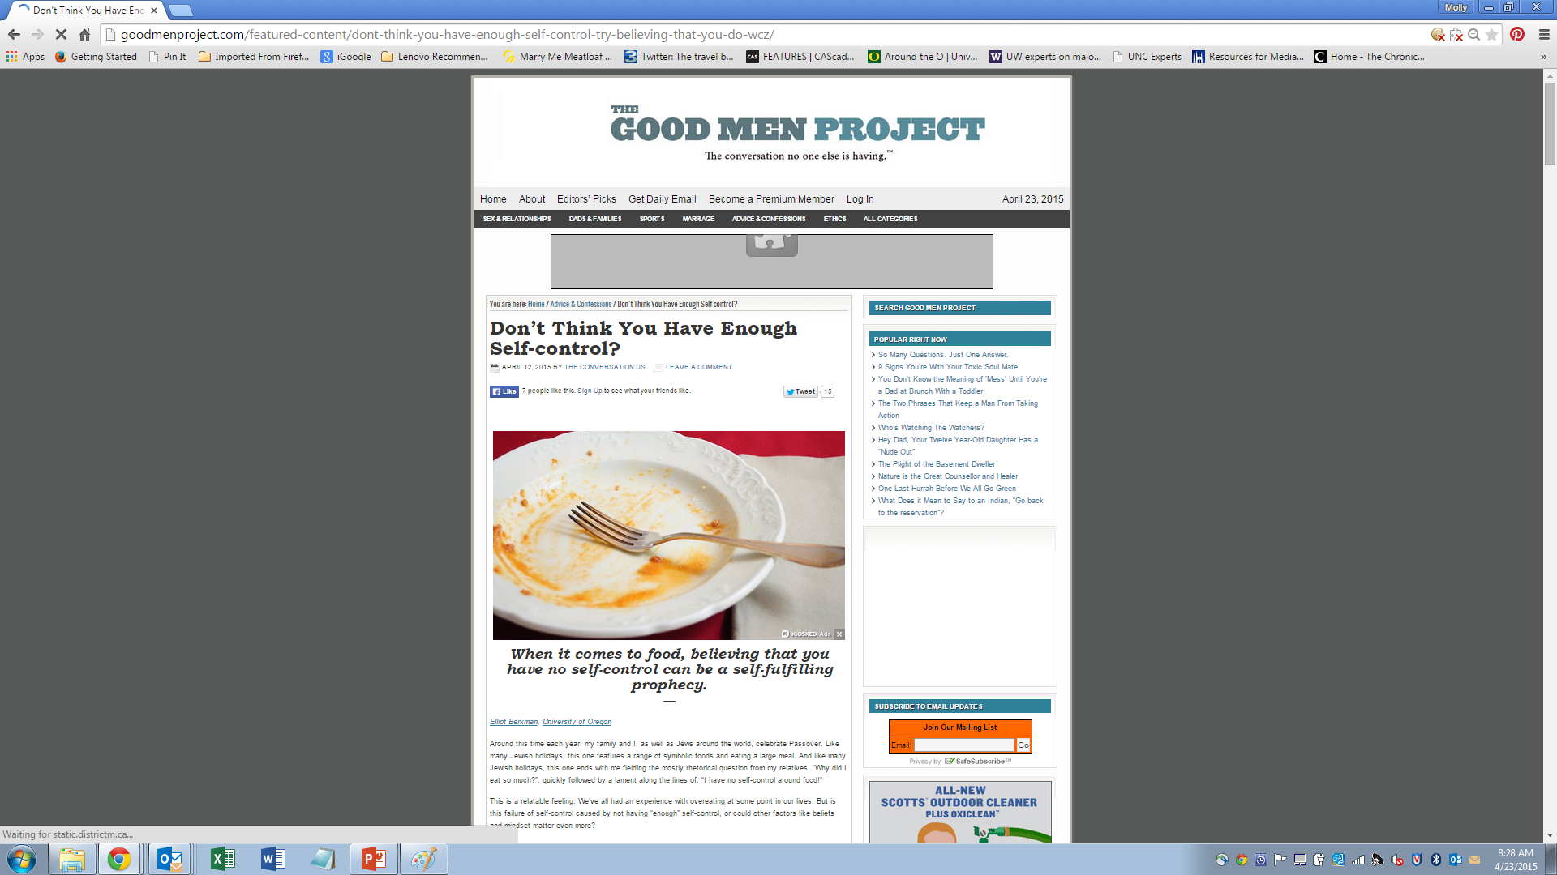
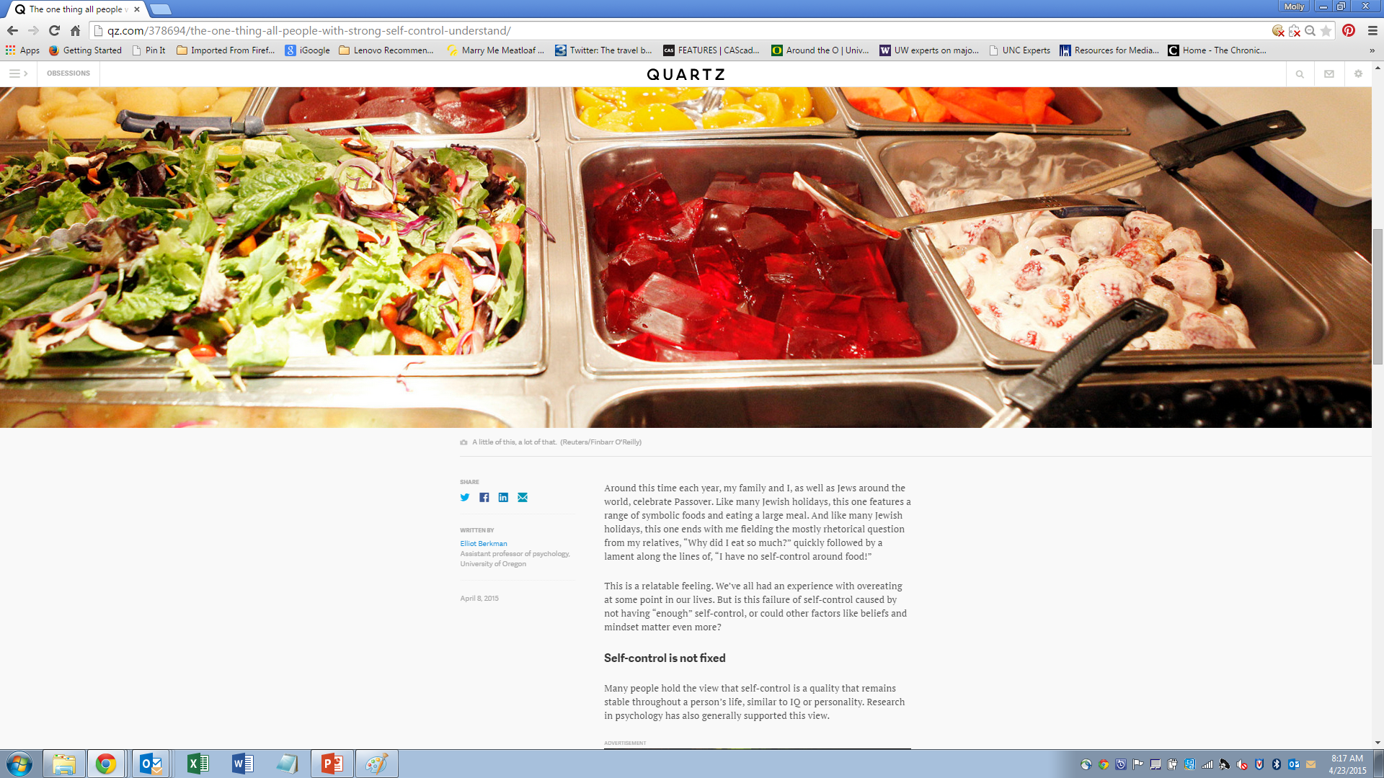

Slide 8
What’s Next?
New Media Ambassadors Website
Media Training
Targeted Twitter Outreach
“Ducks In the News” Outreach

Slide 9
Get Involved
Look for stories with national legs
Look for faculty members who have expertise in issues that are in the news
Send them my way
Encourage faculty to sign up for media training

Slide 10
Contact Me
Molly Blancett
blancett@uoregon.edu 6-9134 Office: 10th & Mill

